Slide 1
Local Exchange Trading System (LETS)

Slide 2
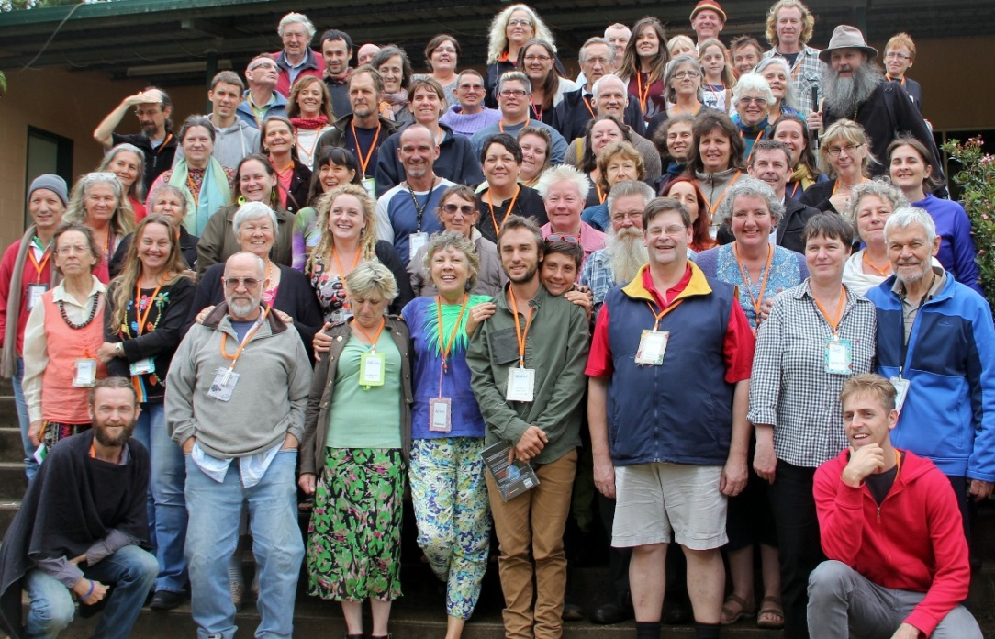
What are LETS systems?
LETS is an acronym for:
Local Energy Trading System
LETS is a network of people across Australia who trade goods and services in their local communities using complementary currencies.

Slide 3
What are Complementary Currencies?
LETS systems have created their own currencies to complement money (as opposed to replacing it).
Currencies in LETS systems are often referred to as “local” or “community” currency, “mutual credit” or “Units”, and each LETS system has a name for its own currency.
LETS currency is virtual and intangible, does not generate interest and has no intrinsic value. Therefore, it is only useful for trading - within LETS!
The value of LETS Units corresponds with monetary value (e.g. 1 unit = AU$1) – however, LETS currency cannot be exchanged for dollars.

Slide 4
So, it’s like bartering?
LETS systems are often compared to bartering systems, however they are quite different.
Barter is the act of exchanging goods and services in a reciprocal manner.
When you exchange in LETS, you can trade without having to reciprocate directly to the same person.
Confusing? This is best illustrated with an example…

Slide 5
Tim: Web Designer
Marina: Photographer
Tim “buys” 3 photos from Marina for his website.
Marina debits Tim’s account for the photos she “sold” him. Marina uses her units to engage a book keeper, Jess
Jess: Bookkeeper
Jessica debits Marina’s account

Slide 6
What kinds of goods and services?
The kinds of goods and services available in LETS depend on the supply and demand of each group. The more members there are, the more goods and services there are available!
Examples of goods:
Food, e.g. home grown veggies & fruit
Pre-loved items, e.g. clothes and furniture
Arts and crafts
Kitchenware and books
Examples of services:
Gardening & cleaning
Accommodation
Transportation
Massage
Web Development
Cooking
Trailer Hire

Slide 7
Brief LETS History
LETS was founded in 1983 by Michael Linton in Comox Valley, Canada.
The idea spread across the world to Europe, Africa, Latin America, and Oceania.
The first Australia LETS system was founded in 1987 in Maleny, QLD by Jill Jordan and Ian Smith.
After the instant success of Maleny LETS, the idea spread across Australia.
In 1989 LETS received government funding to further develop the project, and several LETS systems shut down after this time.
In 2007 LETSystems began to sign up to the CES (Community Exchange System).
In the present day, there are over 50 community exchange systems in Australia registered on the site.
Michael Linton

Slide 8
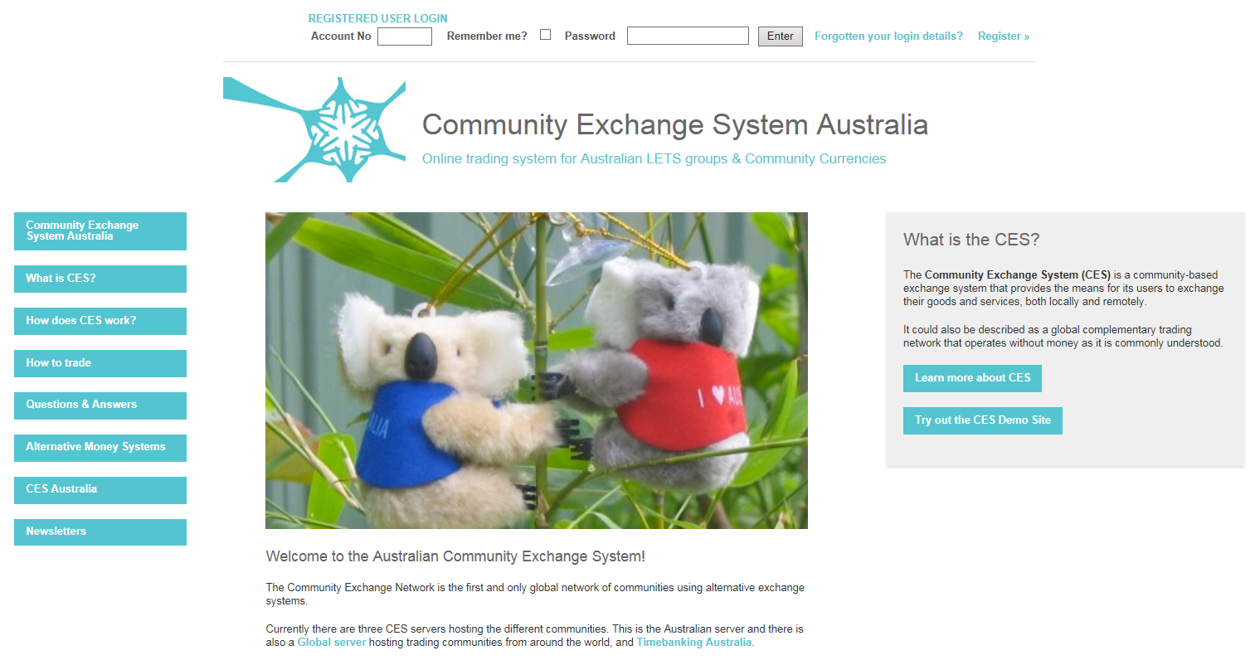
CES Software
LETSystems in Australia are connected to a free online trading software called the CES (Community Exchange System) to administer their transactions.
The CES not only provides an accounting system, but also a network for members to post their wants and offers, and to view other members offers.
Furthermore, the CES connects LETSystems all over Australia and the world, which allows inter-trading.
A major update of the CES is planned to be completed within a year.
There are over 50 active groups on the Australian CES.
www.communityexchange.org.au

Slide 9
Melbourne Eastern Region LETS Incorporated (MERLETS)
Merlets.org.au
Formed on 24th June 1991 in the eastern region of Melbourne, MERLETS is a not for profit local community group.
Membership allows you to exchange your skills, services & goods with other members for tokens, not money. It is a time based system where one hour of service is equivalent to 25 tokens. You can trade with any other member within the LETS system – within MERLETS, Australia & worldwide.
Members extend through Maroondah, Manningham, Whitehorse, Knox & the Yarra Ranges. Within these communities a number of centralised local community hubs have formed that actively trade & support each other.

